Slide 1
Regression Algorithms
Linear Regression – Performance Metrics
Prof. H.P.Channe

Slide 2
Regression
What is Regression Analysis?
Regression is a technique used to model and analyze the relationships between variables.
How they contribute and are related to producing a particular outcome together.
A linear regression refers to a regression model that is completely made up of linear variables.
Regression analysis is a form of predictive modelling technique which investigates the relationship between a dependent (target) and independent variable (s)(predictor).
This technique is used for forecasting, time series modelling and finding the casual effect relationship between the variables.
For example, relationship between rash driving and number of road accidents by a driver is best studied through regression.

Slide 3
Uses of Regression Analysis
There are multiple benefits of using regression analysis. They are as follows:
It indicates the significant relationships between dependent variable and independent variable.
It indicates the strength of impact of multiple independent variables on a dependent variable.
Regression analysis also allows us to compare the effects of variables measured on different scales, such as the effect of price changes and the number of promotional activities.
These benefits help market researchers / data analysts / data scientists to eliminate and evaluate the best set of variables to be used for building predictive models.
Regression analysis estimates the relationship between two or more variables.
Example:
We want to estimate growth in sales of a company based on current economic conditions.
You have the recent company data which indicates that the growth in sales is around two and a half times the growth in the economy.
Using this insight, we can predict future sales of the company based on current & past information.

Slide 4
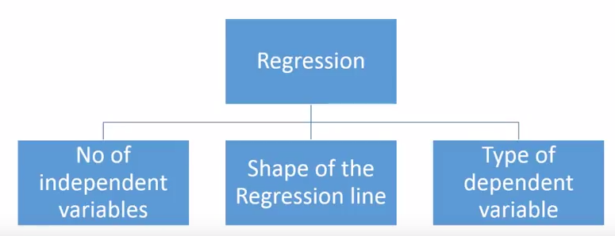
Types of Regression Techniques
There are various kinds of regression techniques available to make predictions.The truth is that there are innumerable forms of regressions, which can be performed.
Each form has its own importance and a specific condition where they are best suited to apply.
These techniques are mostly driven by three metrics .
Figure source www.analyticsvidhya.com

Slide 5
Terminologies related to regression analysis
1. Outliers
Oservation in the dataset which is having a very high or very low value as compared to the other observations in the data. An outlier is a problem because many times it hampers the results we get.
2. Multicollinearity
When the independent variables are highly correlated to each other then the variables are said to be multicollinear. Many types of regression techniques assumes multicollinearity should not be present in the dataset. It is because it causes problems in ranking variables based on its importance. Or it makes job difficult in selecting the most important independent variable (factor).
3. Heteroscedasticity
When dependent variable's variability is not equal across values of an independent variable, it is called heteroscedasticity. Example -As one's income increases, the variability of food consumption will increase. A poorer person will spend a rather constant amount by always eating inexpensive food; a wealthier person may occasionally buy inexpensive food and at other times eat expensive meals. Those with higher incomes display a greater variability of food consumption.
4. Underfitting and Overfitting
When we use unnecessary explanatory variables it might lead to overfitting. Overfitting means that our algorithm works well on the training set but is unable to perform better on the test sets. It is also known as problem of high variance.

Slide 6
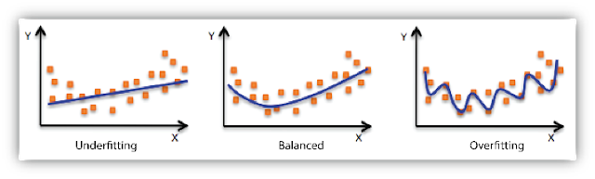
Underfitting and Overfitting
Figure source- www.listendata.com Underfitting and Overfitting

Slide 7
Types of Regression
Principle Components Regression (PCR)
Partial Least Squares (PLS) Regression
Support Vector Regression
Ordinal Regression
Poisson Regression
Negative Binomial Regression
Quasi Poisson Regression
Cox Regression
Tobit Regression
Linear regression
Logistic regression
Polynomial regression
Quantile regression
Ridge regression
Lasso regression
Elastic Net regression

Slide 8
The most commonly used 7 types of regression
Linear Regression
Logistic Regression
Polynomial Regression
Stepwise Regression
Ridge Regression
Lasso Regression
ElasticNet Regression

Slide 9
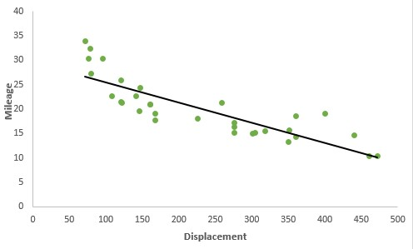
Linear Regression
It is the simplest form of regression. It is a technique in which the dependent variable is continuous in nature.
The relationship between the dependent variable and independent variables is assumed to be linear in nature.We can observe that the given plot represents a somehow linear relationship between the mileage and displacement of cars.
The green points are the actual observations while the black line fitted is the line of regression.
Simple Linear Regression: When you have only 1 independent variable and 1 dependent variable, it is called simple linear regression. Multiple Linear Regression: When you have more than 1 independent variable and 1 dependent variable, it is called Multiple linear regression.
Figure source www.listendata.com Simple Linear regression

Slide 10

Multiple Linear Regre
The equation of multiple linear regression is listed below:
Here 'y' is the dependent variable to be estimated, and X are the independent variables and ε is the error term. βi’s are the regression coefficients.

Slide 11
Assumptions of Linear Regression
There must be a linear relation between independent and dependent variables.
There should not be any outliers present.
No heteroscedasticity
Sample observations should be independent.
Error terms should be normally distributed with mean 0 and constant variance.
Absence of multicollinearity and auto-correlation.

Slide 12


Estimating the Parameters
To estimate the regression coefficients βi’s we use principle of least squares which is to minimize the sum of squares due to the error terms i.e.
On solving the above equation mathematically we obtain the regression coefficients as:

Slide 13
Interpretation of regression coefficients
Let us consider an example where the dependent variable is marks obtained by a student and explanatory variables are number of hours studied and no. of classes attended.
Suppose on fitting linear regression we got the linear regression as:
Marks obtained = 5 + 2 (no. of hours studied) + 0.5(no. of classes attended)
Thus we can have the regression coefficients 2 and 0.5 which can interpreted as:
If no. of hours studied and no. of classes are 0 then the student will obtain 5 marks.
Keeping no. of classes attended constant, if student studies for one hour more then he will score 2 more marks in the examination.
Similarly keeping no. of hours studied constant, if student attends one more class then he will attain 0.5 marks more.

Slide 14
Performance Metrics
Regression task is the prediction of the state of an outcome variable at a particular timepoint with the help of other correlated independent variables.
The regression task, unlike the classification task, outputs continuous value within a given range.
The various metrics used to evaluate the results of the prediction are :
Mean Squared Error(MSE)
Root-Mean-Squared-Error(RMSE).
Mean-Absolute-Error(MAE).
R² or Coefficient of Determination.
Adjusted R²

Slide 15
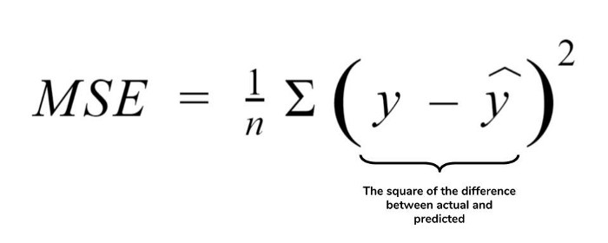
1. Mean Squared Error (MSE)
MSE or Mean Squared Error is one of the most preferred metrics for regression tasks.
It is simply the average of the squared difference between the target value and the value predicted by the regression model.
As it squares the differences, it penalizes even a small error which leads to over-estimation of how bad the model is.
It is preferred more than other metrics because it is differentiable and hence can be optimized better.

Slide 16
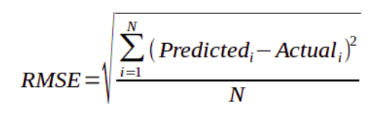
2. Root Mean Squared Error (RMSE)
RMSE is the most widely used metric for regression tasks and is the square root of the averaged squared difference between the target value and the value predicted by the model.
It is preferred more in some cases because the errors are first squared before averaging which poses a high penalty on large errors.
This implies that RMSE is useful when large errors are undesired.

Slide 17
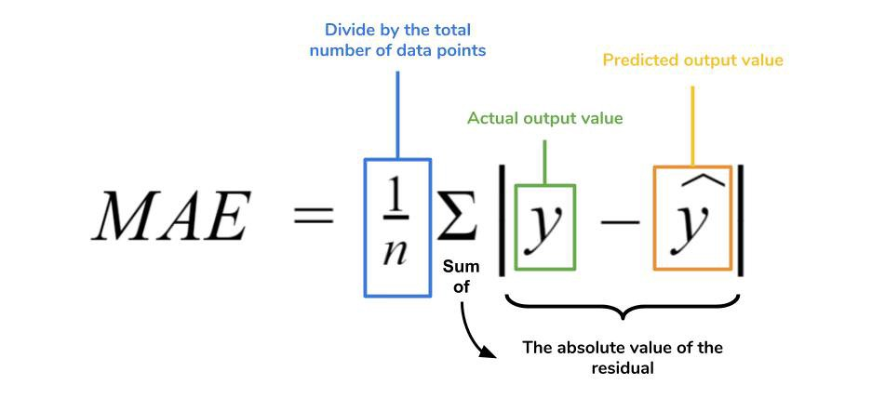
3. Mean Absolute Error (MAE)
MAE is the absolute difference between the target value and the value predicted by the model.
The MAE is more robust to outliers and does not penalize the errors as extremely as mse.
MAE is a linear score which means all the individual differences are weighted equally.
It is not suitable for applications where you want to pay more attention to the outliers.

Slide 18
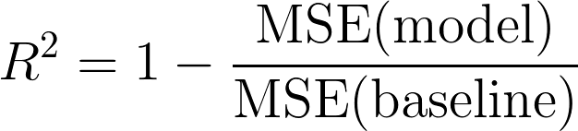
R² Error
Coefficient of Determination or R² is another metric used for evaluating the performance of a regression model.
The metric helps us to compare our current model with a constant baseline and tells us how much our model is better.
The constant baseline is chosen by taking the mean of the data and drawing a line at the mean.
R² is a scale-free score that implies it doesn't matter whether the values are too large or too small, the R² will always be less than or equal to 1.
Figure 4.source www.towardsdatascience.com- The Formula for R²

Slide 19
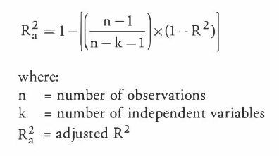
Adjusted R²
Adjusted R² depicts the same meaning as R² but is an improvement of it.
R² suffers from the problem that the scores improve on increasing terms even though the model is not improving which may misguide the researcher. Adjusted R² is always lower than R² as it adjusts for the increasing predictors and only shows improvement if there is a real improvement.

Slide 20
References
David Dietrich, Barry Hiller, “Data Science & Big Data Analytics”, EMC education services, Wiley publications, 2012, ISBN0-07-120413-X
www.analyticsvidhya.com
www.tutorialpoints.com
Www.listendata.com
www.machinelearningplus.com

